Slide 1
THREAT MODELING AND ATTACK TREES PRESENTATION BY
Mpirirwe Byanagwa Stephen
Oluka Tony
Kimbugwe Nasser
Namisanvu Rashidah Kasauli

Slide 2
Introduction
There are always reports of security bugs after security bugs. So it is increasingly clear that the term "security" doesn't have meaning unless also you know things like "Secure from whom?" or "Secure for how long?" [1]
Bruce[1] says that if we can understand different all the different ways in which a system can be attacked, we can likely design countermeasures to prevent those attacks. Therefore what we need is a way to model threats against computer systems.

Slide 3
Definition: Thread Modeling
Threat modeling is a process of assessing and documenting a system’s security risks.
Security threat modeling helps you to understand a system’s threat profile by examining it through the eyes of your potential enemies.
Thread modeling can also be seen as a semi-formal technique that is used to understand threats against your system/s.

Slide 4
Terminologies
Asset. A resource of value, such as the data in a database or on the file system. A system resource.
Threat. A potential occurrence, malicious or otherwise, that might damage or compromise your assets.
Vulnerability. A weakness in some aspect or feature of a system that makes a threat possible. Vulnerabilities might exist at the network, host, or application levels.
Attack (or exploit). An action taken by someone or something that harms an asset. This could be someone following through on a threat or exploiting a vulnerability.
Countermeasure. A safeguard that addresses a threat and mitigates risk.

Slide 5
An overview of the threat modeling process
1. Identify assets.
Identify the valuable assets that your systems must protect.
2. Create an architecture overview.
Use simple diagrams and tables to document the architecture of your application, including subsystems, trust boundaries, and data flow.
3. Decompose the application.
Decompose the architecture of your application, including the underlying network and host infrastructure design, to create a security profile for the application. The aim of the security profile is to uncover vulnerabilities in the design, implementation, or deployment configuration of your application.

Slide 6
Cont’d
4. Identify the threats.
Keeping the goals of an attacker in mind, and with knowledge of the architecture and potential vulnerabilities of your application, identify the threats that could affect the application.
5. Document the threats.
Document each threat using a common threat template that defines a core set of attributes to capture for each threat.
6. Rate the threats.
Rate the threats to prioritize and address the most significant threats first. These threats present the biggest risk. The rating process weighs the probability of the threat against damage that could result should an attack occur. It might turn out that certain threats do not warrant any action when you compare the risk posed by the threat with the resulting mitigation costs.

Slide 7
The Output of Threat Modeling
The output from the threat modeling process is a document for the various members of your project team. It allows them to clearly understand the threats that need to be addressed and how to address them. Threat models consist of a definition of the architecture of your application and a list of threats for your application scenario

Slide 8
Who should practice threat Modeling
Everybody
Developers
System administrators
System architects
Consultants

Slide 9
Summary “Threat Modelling”
While you can mitigate the risk of an attack, you do not mitigate or eliminate the actual threat. Threats still exist regardless of the security actions you take and the countermeasures you apply. The reality in the security world is that you acknowledge the presence of threats and you manage your risks. Threat modeling can help you manage and communicate security risks across your team.
Treat threat modeling as an iterative process. Your threat model should be a dynamic item that changes over time to cater to new types of threats and attacks as they are discovered. It should also be capable of adapting to follow the natural evolution of your application as it is enhanced and modified to accommodate changing business requirements.

Slide 10
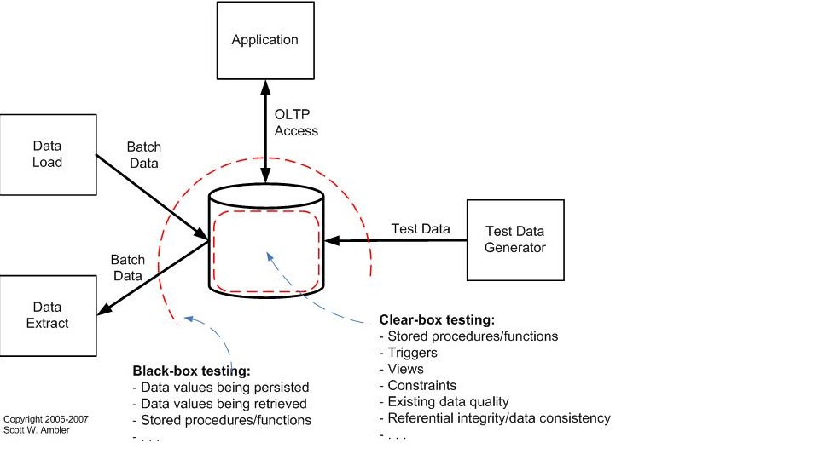
A UML deployment diagram with threat/privilege boundaries

Slide 11
Attack Trees
Attack trees are techniques that can be used to identify strategies to mitigate potential threats to your system.
They provide a formal, methodical way of describing security of systems based on varying attacks.
Basically, you represent attacks against the system in a tree structure, with the goals as the root node and different ways of achieving that goal as a leaf node.
Notes:
Attack trees are just one of the many techniques used in Threat modeling.

Slide 12
Creating attack trees
Identify the possible attack goals. Each goal forms a separate tree.
Think of all attacks against each goal
Add them to the tree.
Repeat this process down the tree until you are done
Like any security analysis, creating attack trees requires a certain mindset and takes practice.

Slide 13
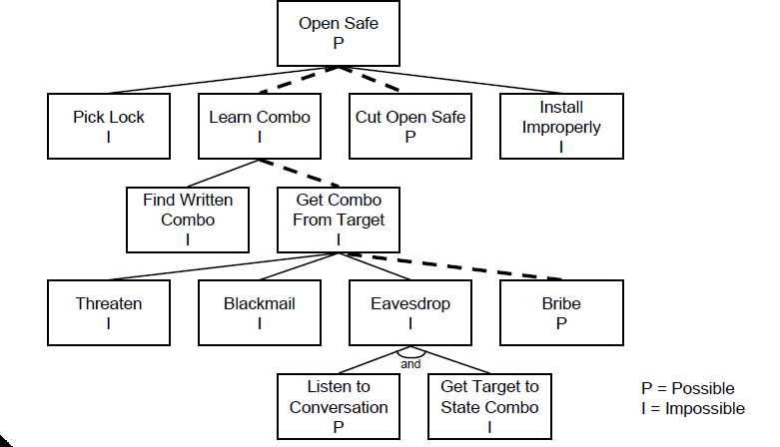
Example of possible Attacks tree

Slide 14
Conclusion
Attack trees provide a formal methodology for analyzing the security of systems and subsystems.
They provide a way to think about security, to capture and reuse expertise about security, and to respond to changes in security. Security is not a product -- it's a process.
Attack trees form the basis of understanding that process.

Slide 15
References
Bruce Schneier Modeling security threats Dr. Dobb's Journal December 1999
http://www.agilemodeling.com/artifacts/securityThreatModel.htm
http://msdn.microsoft.com/en-us/library/ff648644.aspx
http://thinkingstone.com

